Slide 1
Boosting Algorithms

Slide 2
Boosting Algorithm
Ada Boost
XG Boost
LG Boost

Slide 3
Ada Boost
AdaBoost works by sequentially fitting multiple weak learners (often decision trees) to the data.
Each subsequent learner focuses more on the samples that the previous learners mispredicted or had high errors on.
The final prediction is a weighted sum of the predictions from all individual weak learners.

Slide 4
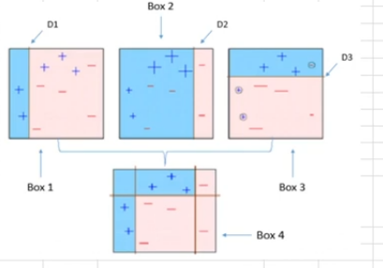


Calculate weight of each tree

Slide 5
Implementation
from sklearn.ensemble import AdaBoostRegressor
To implement the adaboost algorithm implement AdaBoostRegressor from sklearn.ensemble
regressor = AdaBoostRegressor(random_state=100) regressor.fit(X_train, y_train) To create model using adaboost algorithm

Slide 6
Hyper Tuning Parameter
Important parameters and their values are
estimator : By default, it’s a DecisionTreeRegressor with max_depth=3
n_estimators : int, default=50
learning_rate : float, default=1.0
Loss : {‘linear’, ‘square’, ‘exponential’}, default=’linear’

Slide 7
XG Boost Algorithm
It is a advance algorithm that builds the decision tree one by one, where each tree tries to fix the mistakes of the previous tree
powerful approach for building supervised regression models by using the XGBoost objective function and base learners.
The objective function contains loss function and a regularization term.
It tells about the difference between actual values and predicted values, i.e how far the model results are from the real values.
common loss functions for regression problems is reg:linear

Slide 8
Working Mechanism
Initialization: Start with a simple model, such as predicting the mean value for regression.
Iterative Boosting:
Compute the gradient of the loss function for each observation to estimate the residual errors.
Fit a new decision tree to these residuals.
Update the model by adding the predictions of the new tree multiplied by a learning rate (shrinkage factor).
Final Prediction: The combined predictions from all boosted trees produce the final output.

Slide 9
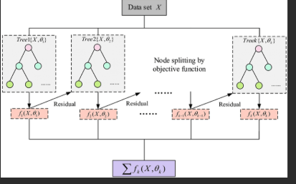

Slide 10
Implementation of XGBoost
Install and import the necessary libraries
!pip install xgboost
import xgboost
Creating Model
regressor = xg.XGBRegressor(objective ='reg:linear', n_estimators = 10, seed = 123)
Regressor.fit(x_train,y_train)

Slide 11
Hyperparameters
n_estimators -This parameter defines the number of boosting stages or the number of weak learners (trees) to be built. More estimators can lead to higher accuracy but also increase the risk of overfitting
learning_rate - The learning_rate scales the contribution of each tree. A smaller learning rate requires more trees
max_depth - max_depth controls the maximum depth of the individual regression estimators (decision trees).
Subsample - specifies the fraction of samples to be used for fitting the individual base learners
Loss - The loss function to be optimized. Common options include squared_error(L2), absolute_error(L1), huber(Combination of L1 and L2)

Slide 12
LG Boost Algorithm
Light Gradient Boosting is implementation of the gradient boosting decision tree algorithm
It is designed for high efficiency and low memory usage, making it effective for large-scale datasets.
It builds decision tree models iteratively, where each new tree focuses on reducing the residual errors of the previous trees.

Slide 13
Key Features
Gradient-based Boosting: Trees are trained sequentially, and each tree aims to minimize a specified loss function
Leaf-wise Tree Growth: Unlike traditional level-wise tree growth, LGBoost uses a leaf-wise strategy which grows trees by splitting the leaf with the maximum loss reduction.
Regularization: To prevent overfitting, LGBoost includes regularization parameters such as max depth, min data in leaf, and L1/L2 penalties on leaf values

Slide 14
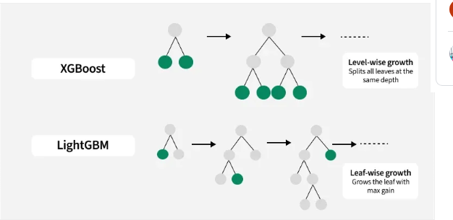

Slide 15
Implementation
Install and import the necessary libraries
!pip install lightgbm
from lightgbm import LGBMRegressor
Creating Model
regressor=LGBMRegressor(objective='regression',metric='rmse’, num_leaves=3,learning_rate=0.05, n_estimators=100)
regressor.fit(x_train,y_train)

Slide 16
Hypertuning parameters
num_leaves - Maximum tree leaves for base learners.
max_depth - Maximum tree depth for base learners.
learning_rate - Boosting learning rate
n_estimators -Number of boosted trees to fit.
objective - Specify the learning task and the corresponding learning objective
class_weight (dict, 'balanced' or None)- Weights associated with classes
metric: Evaluation metric (RMSE)

